Slide 1
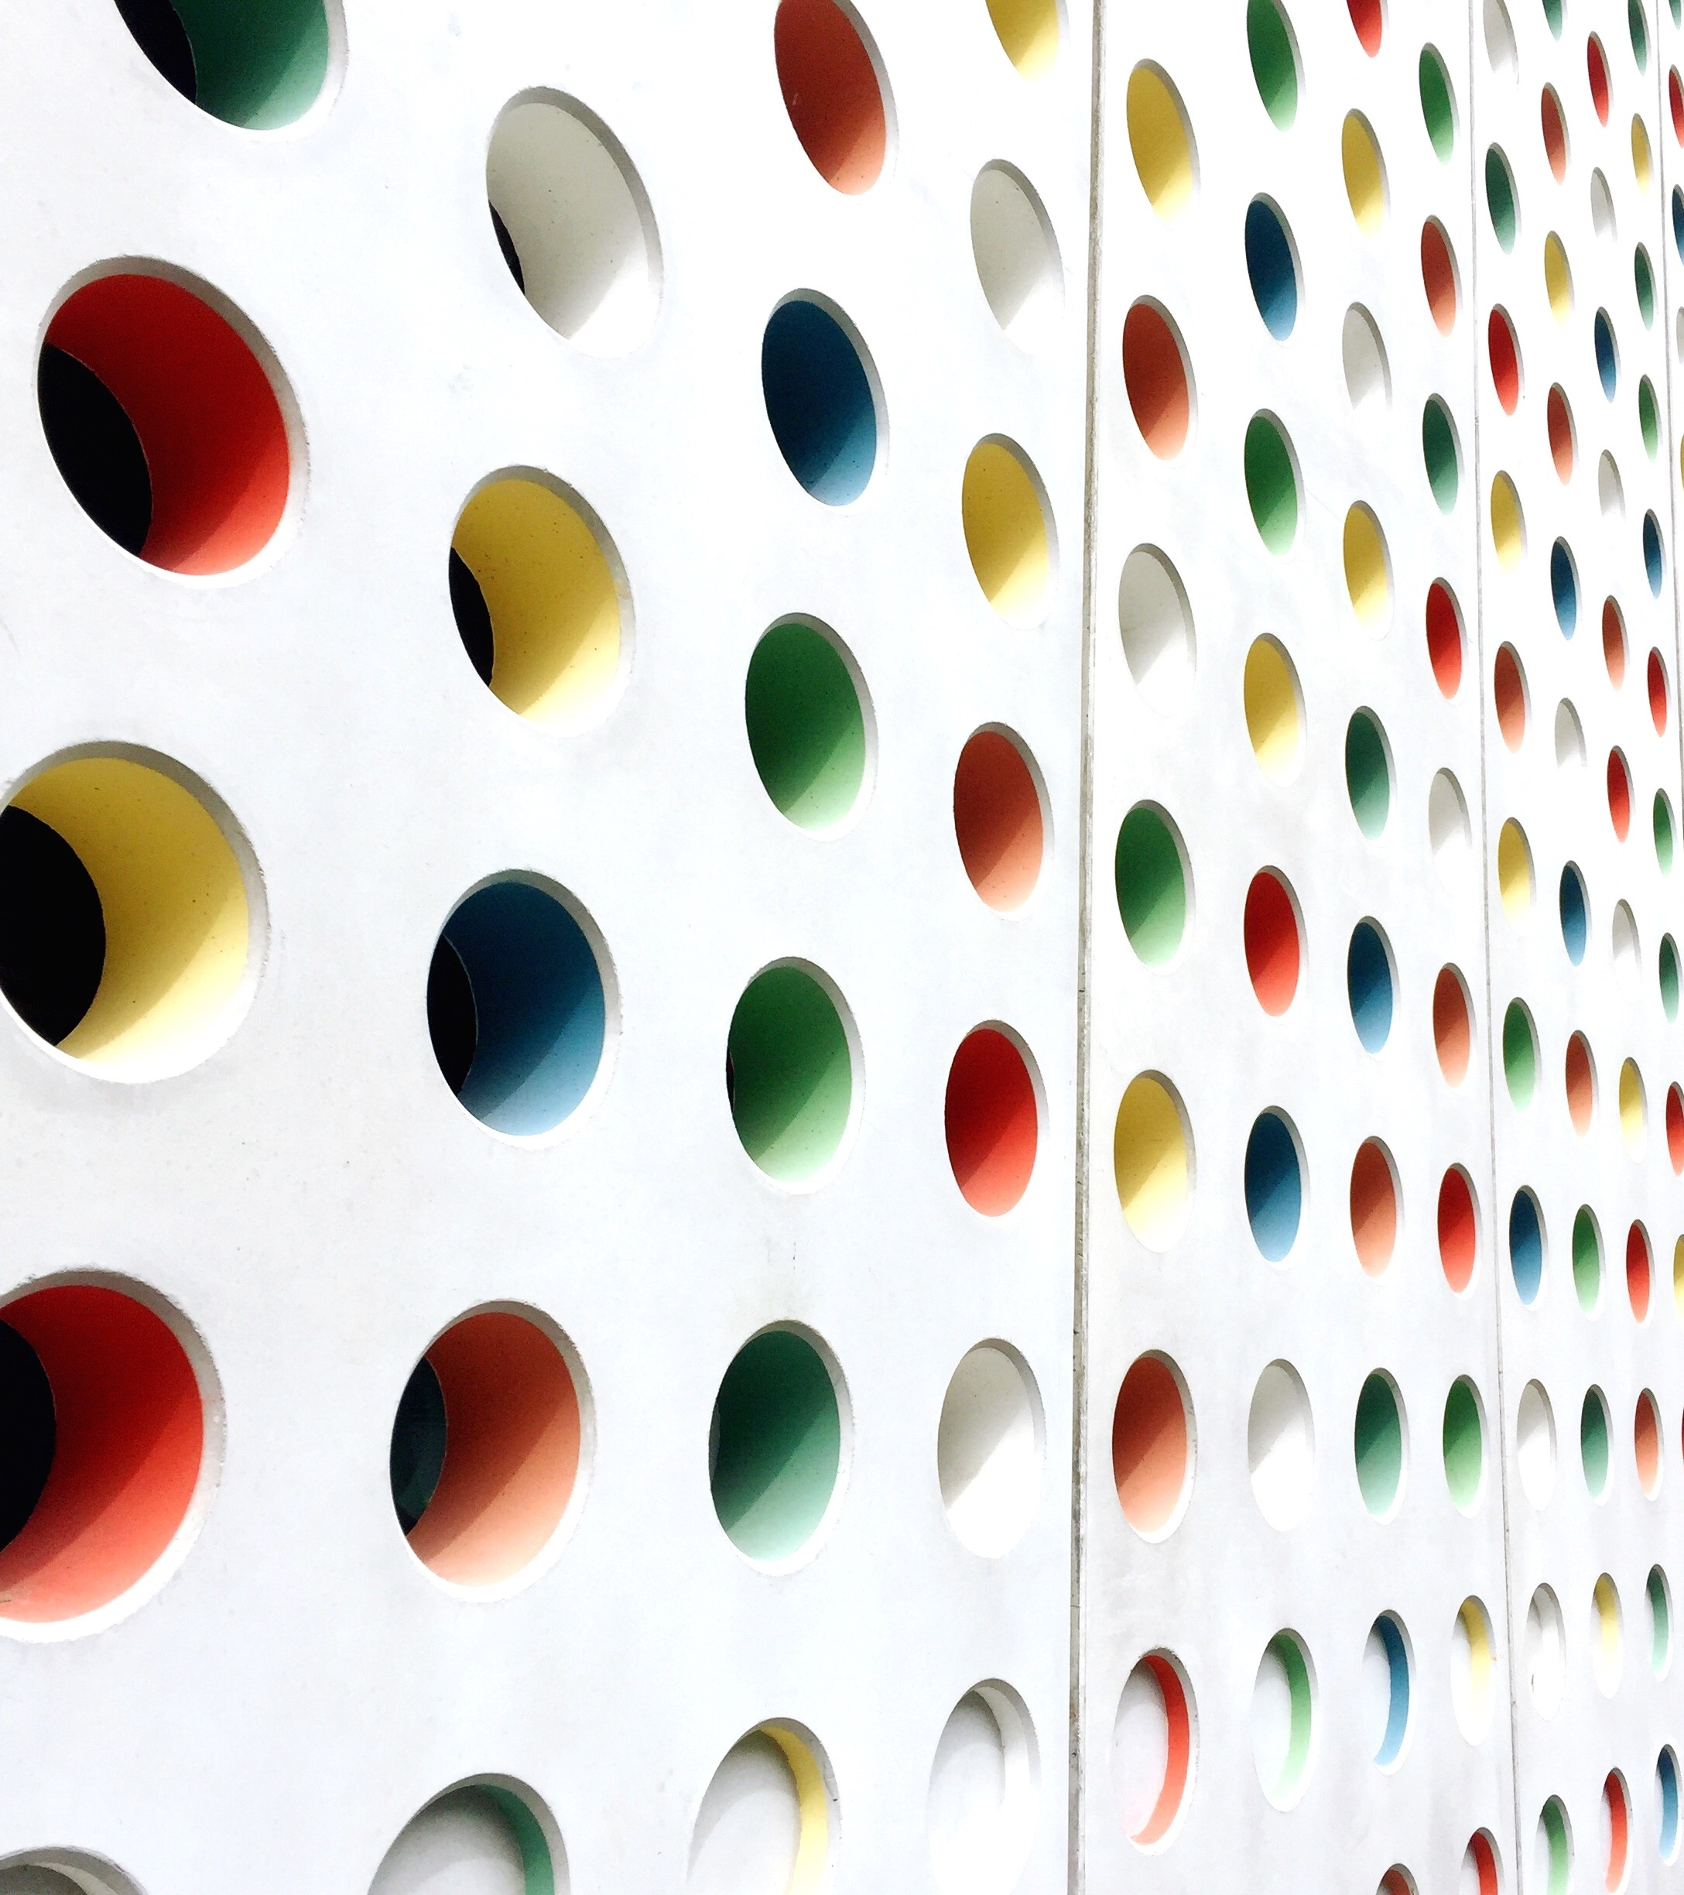
Module 4 Lab 3 Calculator
Dewi Fitriasari

Slide 2
Link to Git:
https://github.com/dfworkroom01/M4-Lab3-Calculator
Link to Figma Hi-Fi Prototype:
https://www.figma.com/proto/OBw25rDS6G3wjCQFxQDdRt/Calculator-M4L3?node-id=0-1&t=YBuMiou1knTbUwzy-1
Link to Figma Developer:
https://www.figma.com/design/OBw25rDS6G3wjCQFxQDdRt/Calculator-M4L3?node-id=0-1&m=dev&t=E3yTz8PhXFARKX4C-1

Slide 3
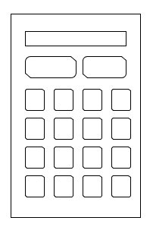
Sketch
Display area where users input numbers and functions
Delete one by one
Reset (empty display)
Math functions
Numbers

Slide 4
Data
Data inputs:
1. Numbers (the use of the dot button enables decimals)
2. Math basic functions (+, -, /, *)
Limitations:
Cannot calculate big integers as JS becomes inaccurate with such input.
There are no advance math functions.

Slide 5
Technology
1. HTML
2. CSS
3. JS Script

Slide 6
Colour Scheme
background: linear-gradient(to right, #1d1c71, #84cdf7, #f5f3f3);
#calculator
background-color: #9c9b9
#display
background-color: #ede9e9
button
background-color: #ecc691

Slide 7
Colour Scheme
button:hover
background-color: #d4d4d4
button.operation
background-color: #060e59
color: #fff
button.operation:hover
background-color: #5e9fb9

Slide 8
Hi-Fi Design
Please refer to the prototype link provided on the same page as the Git link.

